Slide 1
Springboard Data Science Capstone 2
Cole Romanyk

Slide 2
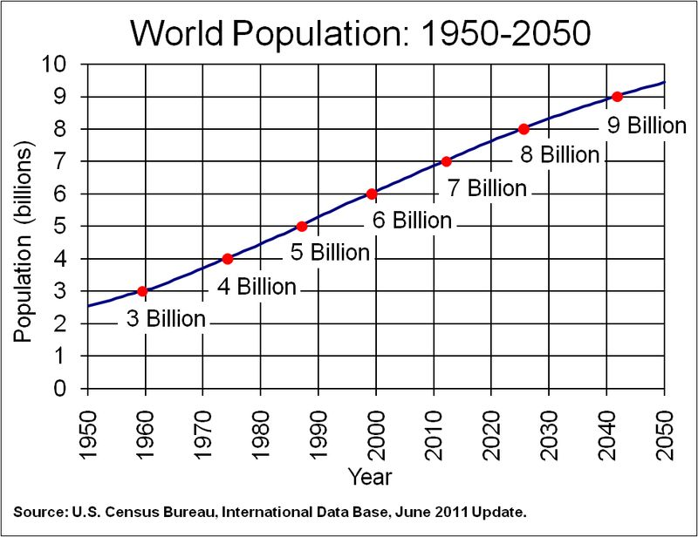
Problem
Reduce farming emissions by 2/3 by 2050
People must eat – Cannot sacrifice yields
Production practices explored:
No-till
Cover cropping

Slide 3
Data Sources
USDA
Indiana State Department of Agriculture
HPRCC
Michigan State University
NOAA

Slide 4
Wrangling
Regression analysis requires:
Complete records
No categorical features
Problems with this dataset:
Years missing data
Very limited sample size

Slide 5
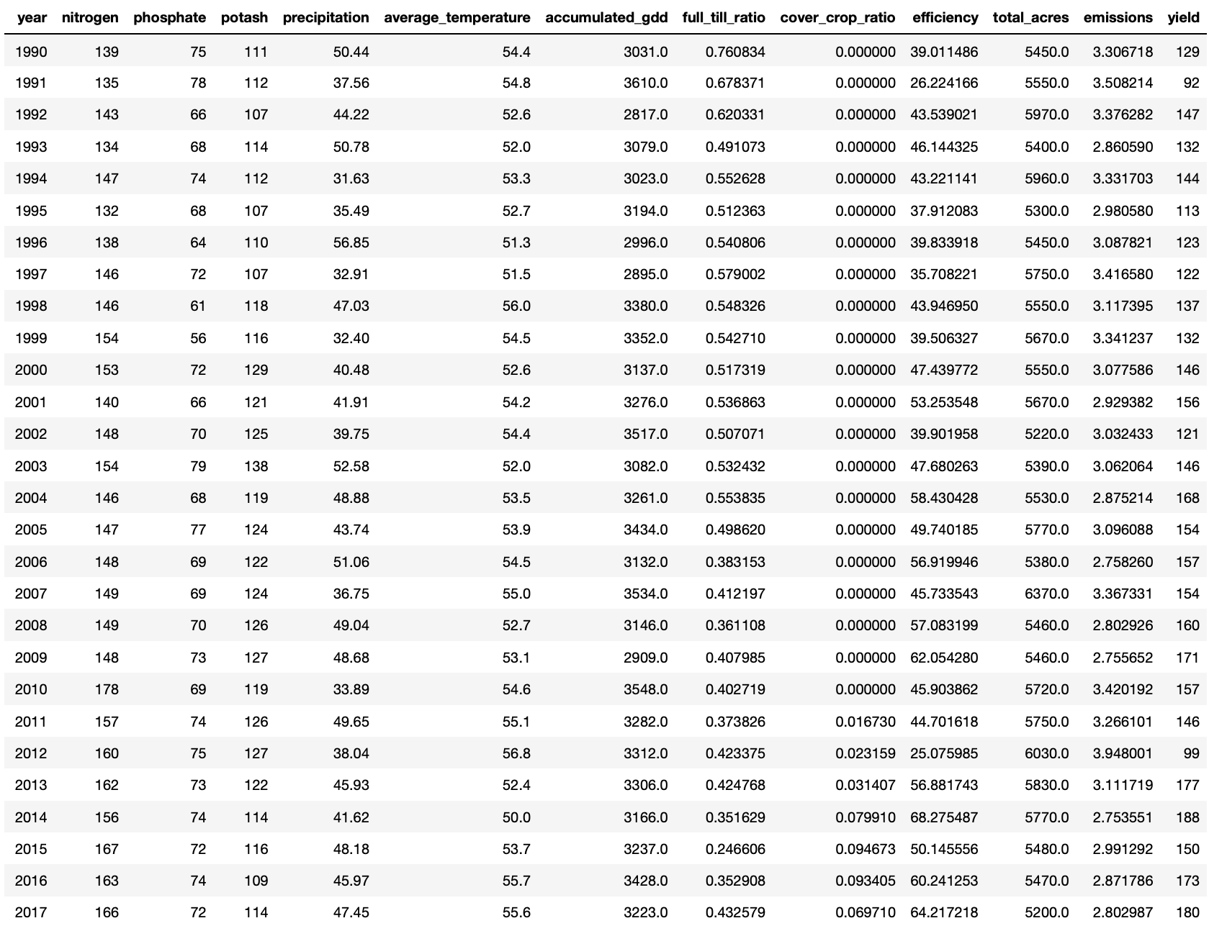
The Data

Slide 6
Models Explored
Regularization embedded:
Ridge
Lasso
Elastic Net
Ensemble methods:
Random Forest
XGBoost

Slide 7
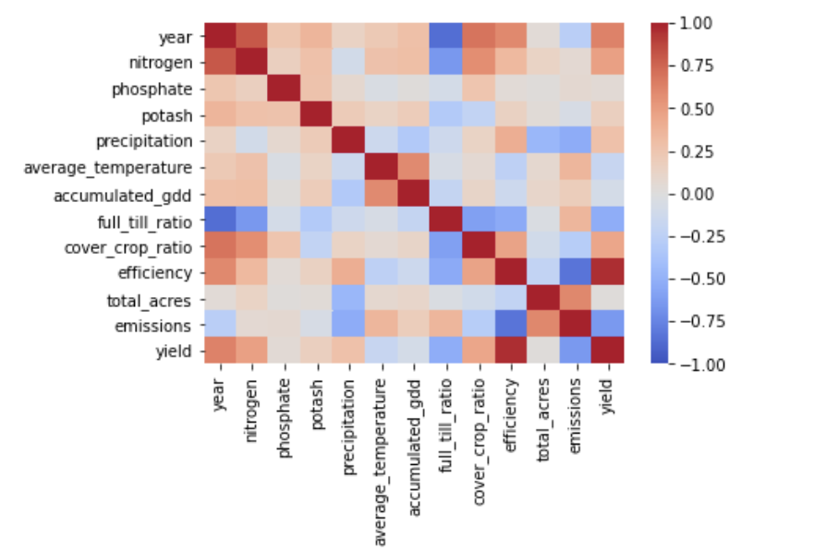
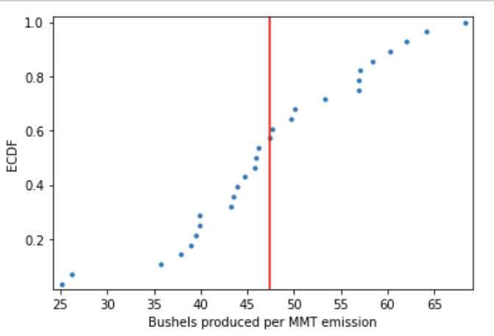
EDA
Data fits regression requirements
Normally distributed
Correlations Signs Accurate
Outliers identified
Simple regression R2 = 0.73

Slide 8
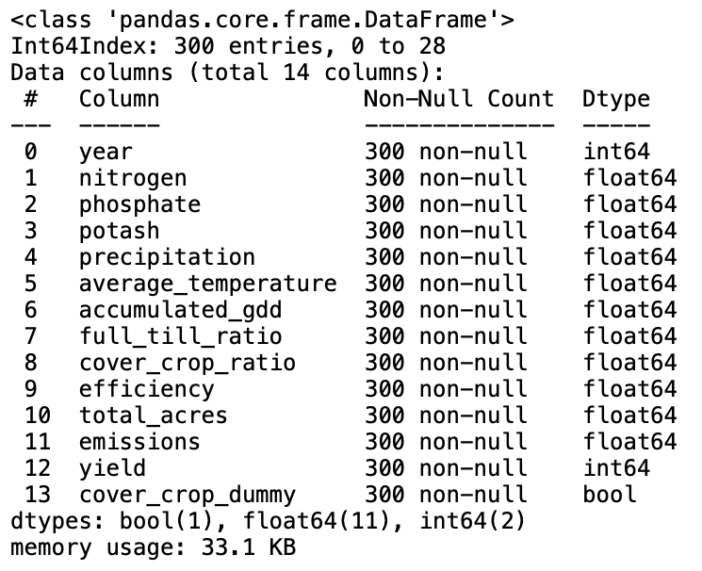
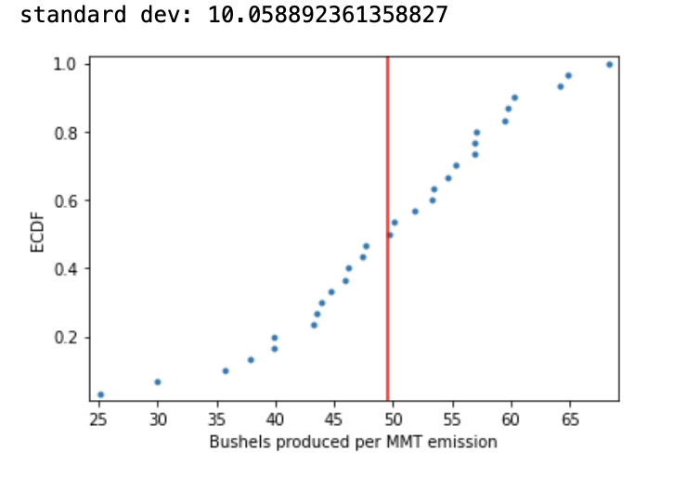
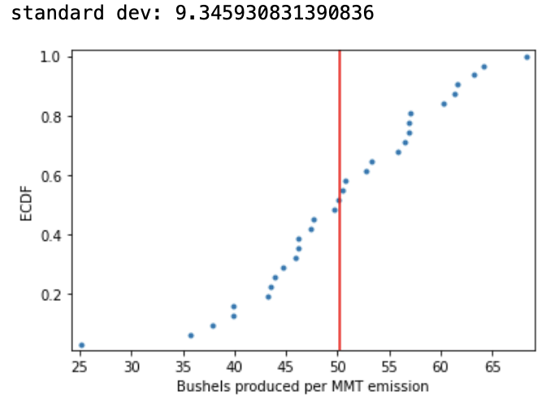
Synthetic Growth Techniques
Techniques used:
SMOTE
ADASYN
Bootstrap

Slide 9
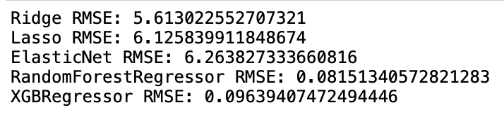
Modeling and Tuning
Preliminary regularization winner:
Ridge
Preliminary ensemble winner:
RF

Slide 10


Test Results
Model’s compared on RMSE performance
Regularization winner:
Ensemble winner:

Slide 11
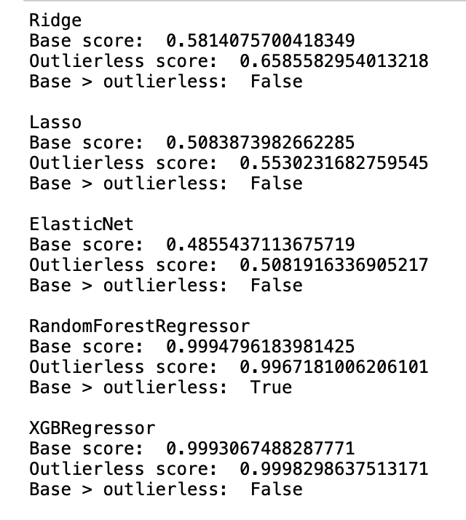
Outlier Evaluation
Outliers significantly influence model performance

Slide 12
Tuned Outlierless Results
Ridge
RMSE: 4.12
R2: .694
XGBoost
RMSE: 4.66
R2: .763

Slide 13
Winner!
Ridge Regression Model
Lower RMSE
Smaller R2
Training and test R2 - less likely to overfit

Slide 14
Notes
R2 used to evaluate final model results because test set standard deviation was great than training set standard deviation.

